Slide 1
Task 1: Initial Problem Statement (Version 1)
A good problem statement should answer the following questions
What is the problem that needs to be solved?
Why is it a problem?
Where is the problem observed?
Who is impacted? (customers, businesses, departments)
When was the problem first observed?
How is the problem observed? What are the symptoms?
How often is the problem observed?
Remember these are generic questions and will not apply to all projects

Slide 2
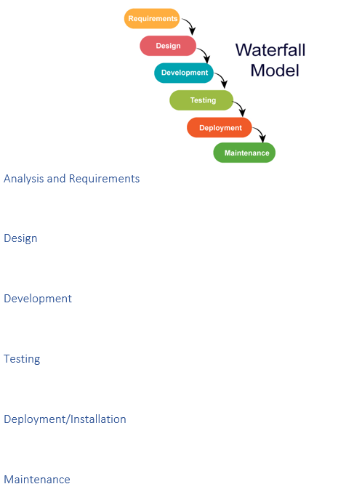
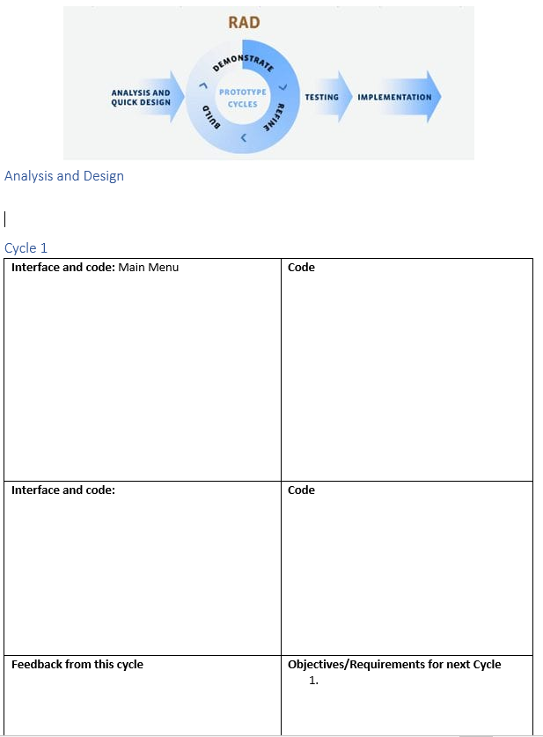
Task 1: Chosen Methodology

Slide 3
Task 1: Task List
The Task list must match your chosen methodology
Tasks can be stages or linked to the stages of your methodology
Remember you must list the task, describe the tools/techniques you will use and explain why you will use them
Possible ideas/structure:
 | Task | Tools/Techniques | Justification
1 | Plan the project | Create a list of tasks Microsoft Planner
2 | Analysis: Research | Secondary Research (Internet)

Slide 4
Task 2: Planning – (Subtitle : Project Plan)
You need to use the list of activities you made in Task 1
You have 3 weeks for this task and your deadline is: Thursday 19th December
Create a Project Plan using project planning tools such as Microsoft Planner
Add each of your project tasks into a planning tool such as Microsoft Planner
Assign each task a due date and assign yourself to every task
Your project plan must take into consideration the chosen methodology
Provide Initial Print Screens of your plan – if you have used MS Planner:
Print Screen the chart view
Print Screen the schedule view
Print Screen the My Tasks View (Tasks must be assigned to you for this to work correctly)
You need to keep this up to date. Planner will keep track of whether you have completed tasks on time which you will need for your evaluation
Make sure you have planner open and mark tasks completed as you finish them
You must provide print screen evidence of your plan after each stage/cycle

Slide 5
Task 2: Project Structure
The evidence structure for your project will be different depending on which type of methodology you choose
Copy the Evidence Layout for your methodology into your assignment document under the task 2 heading (images are not needed)
Traditional (Waterfall) | Agile (RAD)

Slide 6
Task 2: Research – (Part of analysis)
Remember to update your plan (Microsoft Planner) once you complete each task
The propose of this research task is to produce a list of requirements/objectives for the program that you are going to develop
The amount of detail required here will depend whether a traditional or agile method is being used:
Research Activity | Traditional (Waterfall) | Agile (RAD)
1. Secondary Research: Use the internet to find two similar programs. For each one: Describe it (What is it? What is its purpose? Include at least 1 screen shot) Produce a bullet point list of features (Each must be described) | Needed here as part of the full analysis stage | Needed here are part of the initial/quick analysis stage
2. Primary Research: Create a questionnaire (Microsoft Forms – this can be emailed/shared with whoever you want to complete it – try and get two lecturers to do it but ask nicely!) Aim for 10 questions The purpose is to find out what should be included in the program Include a some closed questions (guided questions) Include some open ended questions | Needed here as part of the full analysis stage | Not needed Will be used to inform the second prototype

Slide 7
Task 2: Requirements – (Part of analysis)
Remember to update your plan (Microsoft Planner) once you complete each task
Final part of the analysis stage
This is a Bullet/Numbered list of requirements/objectives
Each requirement/objective should include justification (… this is important because…)
Traditional (Waterfall) | Agile (RAD)
Minimum of 15 requirements/objectives Must be detailed and cover every aspect of the program you are going to develop Explain why each objective is important | Up to 15 requirements/objectives Objectives should cover enough functionality for the first prototype Explain why each objective is important You will need to doe some more analysis and objectives for prototype 2 and any additional program versions
Back to Task 1: Problem Statement
Use your initial problem statement as a starting point you should have:
A final (..ish) problem statement (RAD will need to add more objectives later)
The list of objectives (no need for justification)
An explanation of why the problem statement is now detailed enough to start the design and development

Slide 8
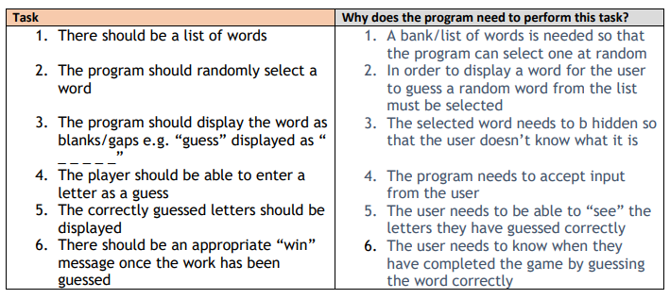
Requirements (Similar Example)
Remember to update your plan (Microsoft Planner) once you complete each task
NOTE
Requirements/objectives NOT tasks
Your solution needs a graphical user interface (Windows Forms?)
Other examples of requirements/objectives can be found in the targets game document

Slide 9
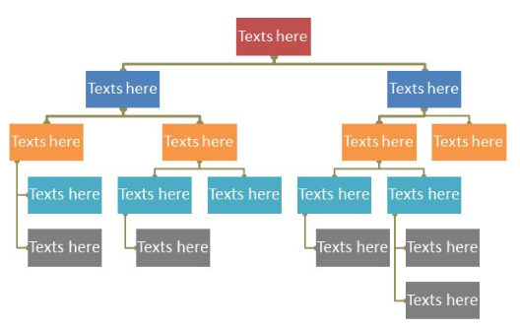
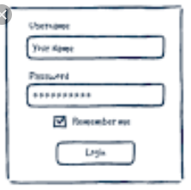
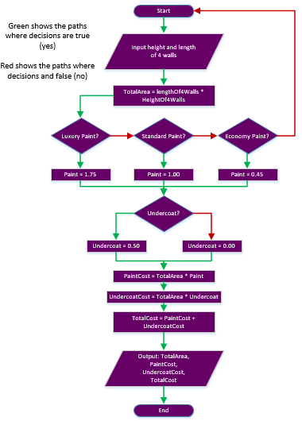

Task 2: Design
Remember to update your plan (Microsoft Planner) once you complete each task
Structure Chart – Interface Structure (Use Visio/PowerPoint/Hand draw) | Interface Designs (Use Visio/PowerPoint/Hand draw)
Flowchart– Overall Program (Use Visio/PowerPoint/Hand draw) | Pseudocode

Slide 10
Task 2: Development
Remember to update your plan (Microsoft Planner) once you complete each task
Develop your program (must have a graphical user interface)
Follow the structure of your selected methodology
You will probably need to add more row/columns to the tables provided
Provide evidence of each interface and the code that goes with it
Code Requirements:
Meaningful variable and object names (e.g. inputName, input_name, exitBtn)
Comments (variables, constructs, procedures, functions etc)
Agile Methodology
Ideally 3 iterations (to create 2 Prototypes and then your “final” program)
After each Prototype:
Some testing is needed (probably a short list of user tests – questionnaire maybe?)
Some new/extra objectives are needed as a result of testing (These can be to fix problems or to add more features

Slide 11
Task 2: Testing (System Testing)
Remember to update your plan (Microsoft Planner) once you complete each task
Once you think the program is finished, you must test all the features of your program this is known as system testing
Use a testing table:
Tests must include normal, extreme and erroneous data inputs (Please colour code them)
Failed tests should be followed up with another test that shows the problem has been corrected
Test Number | Test Purpose | Test Type (normal, extreme, erroneous) | Expected result | Expected result evidence (Print Screen) | Failed result evidence (Print Screen)

Slide 12
Task 3/4/5: Review and Evaluation
Remember to update your plan (Microsoft Planner) once you complete each task
Have the Assignment Brief open
Task 3: Review of the Final Solution
Demonstrate the working program (Record it using CAM studio)
Questionnaire – ask 3+ people to review the program
Task 4: Evaluation of Systems Methodology
Task 5: Demonstration of Individual Responsibility

